Slide 1
Explosive percolation on directed networks
Shannon Moran
PHYS 514 Final Project, Fall 2017

Slide 2
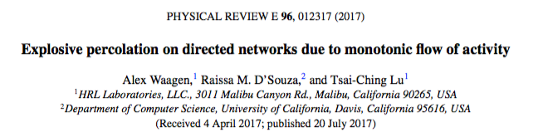
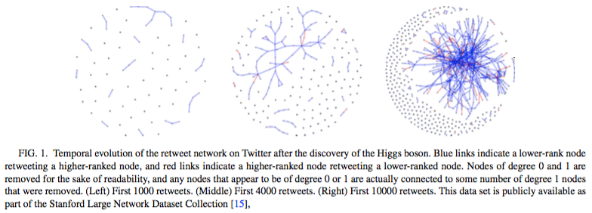
For this project, I wanted to take what we’d learned and apply it to a recent problem

Slide 3
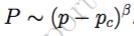
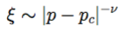
This paper takes the same concepts we studied in class but applies them to networks
 | Studied in class | Used in the paper
Percolation process | Site percolation on a lattice | Edge percolation on a network of nodes
Cluster definition | Clusters of nearest-neighbor occupied sites | Strongly connected components
Clustering algorithm | Hoshen-Kopelman | Tarjan’s Algorithm (depth first search)
Critical exponents | α, β, γ, η, and ν | β... but not the same β

Slide 4
We can think of network percolation as occupied edges, rather than sites
Percolation
Cluster definitions
Cluster algorithms
Critical exponents
Building a directed network
Proposed edge:
(2,3)
(0,4)
(2,3)
(5,1)
Initialize n nodes (unique order)
Pick two nodes at random: (tail, head) of edge
Choose which edge to add
If edge exists: check if reverse edge exists
If reverse edge exists: pass Else: add reverse edge
Else: add edge
Repeat 2&3 until m edges are added
1
2
0
3
5
4
Edge density = δ = m/n
“Erdős-Rényi directed network”
Source: P. Erdős and A. Rényi, On Random Graphs, Publ. Math. 6, 290 (1959)

Slide 5
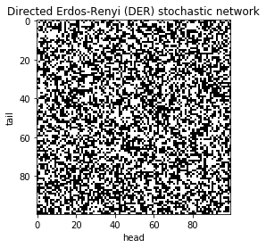
Directed Erdos-Renyi (DER) networks do not have any bias
Percolation
Cluster definitions
Cluster algorithms
Critical exponents
Edge exists
No edge
Note: Network size of n=1e2; edge probability set to 50/n to correspond to an edge density of 50 for C-ODER and ODER graphs

Slide 6
Paper introduces two variations on DER
Percolation
Cluster definitions
Cluster algorithms
Critical exponents
 | DER | Ordered DER | Competitive, Ordered DER
Initialize | Initialize nodes w/unique labels | Initialize nodes w/unique labels | Initialize nodes w/unique labels
Propose edge | Pick two nodes at random: (tail, head) of edge | Pick two nodes at random: (tail, head) of edge THEN order so proposed head is larger than tail | Pick three nodes at random: (a,b,c) THEN order so a<b<c THEN choose (a,b) OR (b,c) s.t. the difference in node rank is minimized for the proposed edge
Add edge (or not) | If edge exists: check if reverse edge exists If reverse edge exists: pass Else: add reverse edge Else: add edge | If edge exists: check if reverse edge exists If reverse edge exists: pass Else: add reverse edge Else: add edge | If edge exists: check if reverse edge exists If reverse edge exists: pass Else: add reverse edge Else: add edge
``

Slide 7
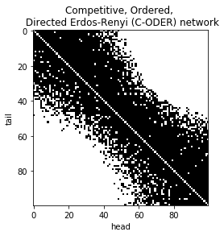
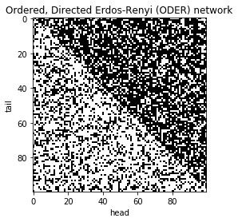
These two algorithms yield very different network structures from these changes
Percolation
Cluster definitions
Cluster algorithms
Critical exponents
Edge exists
No edge
Note: Network size of n=1e2; edge density of 50

Slide 8
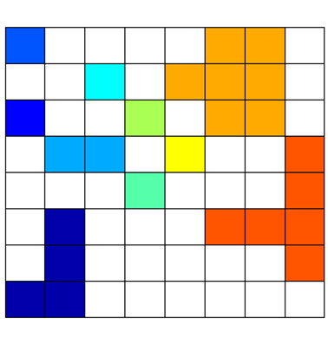
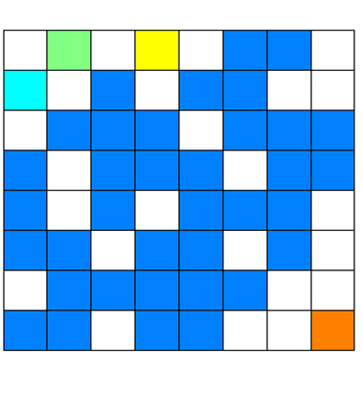
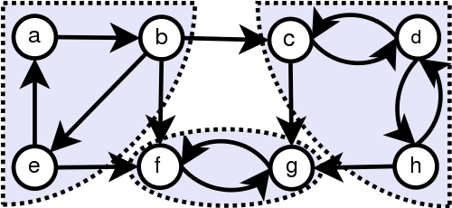
In networks, we have to define clusters differently– strongly connected components
Percolation
Cluster definitions
Cluster algorithms
Critical exponents
Lattice percolation
Network percolation
“Strongly connected components”
Lattice percolation source: http://www.physics.usyd.edu.au/teach_res/mp/doc/percolation.htm
Network percolation source: https://commons.wikimedia.org/wiki/File:Scc.png
Notes:
A strongly-connected component of a directed graph G is a maximal subset V' of the vertices with the property that every node in V' is reachable from every other node in V'. What makes strongly-connected components different from connected components in undirected graphs is that in an undirected graph, if you can reach v from u, you can go backwards along the same path to reach u from v; but in a directed graph, it may be that you can reach v from u but not be able to go back.

Slide 9
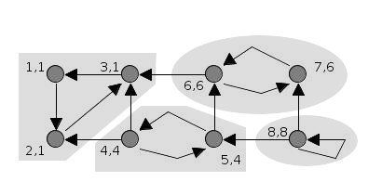
We can identify these strongly connected components using Tarjan’s algorithm
Percolation
Cluster definitions
Cluster algorithms
Critical exponents
Tarjan’s algorithm is a depth first search
Two parameters are tracked for each node, v
v.index = time stamp at which vertex v is discovered
v.low = oldest ancestor v can reach
For each node:
For each child:
If child has already been visited: recursively run this function, v.low = min of the node’s low and the child’s low
Elif child is in the current stack: v.low is the minimum of node’s low and child’s low
If v.low and v.index are equal, the stack down to the node is one SCC
Gif source: https://commons.wikimedia.org/wiki/File:Tarjan%27s_Algorithm_Animation.gif
Notes:
Running into some stack overflow issues for n=1e4 or above– limiting how large I could make my samples

Slide 10
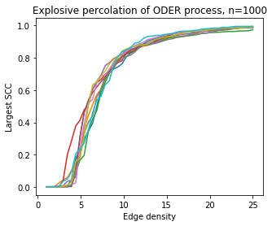
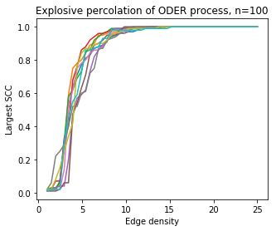
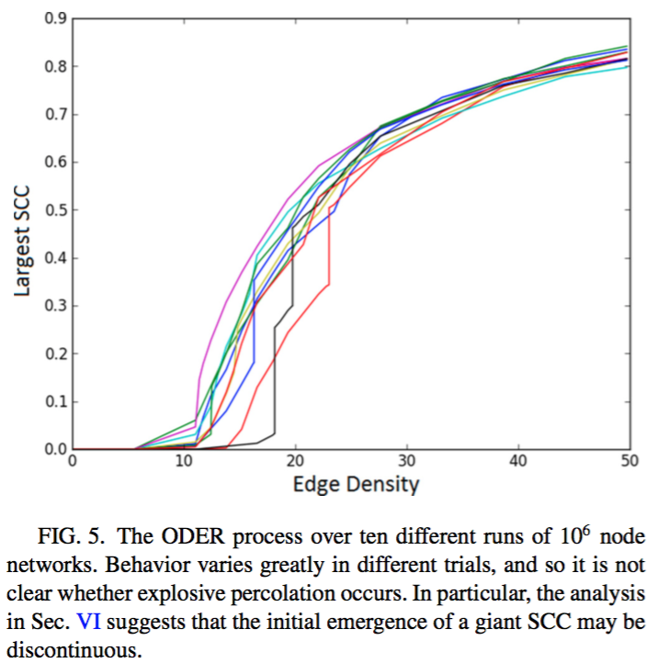
ODER: Able to replicate paper’s observed SCC trends versus edge density (w/caveat)
Percolation
Cluster definitions
Cluster algorithms
Critical exponents
Target results
My results
Simulation notes: 10 replicates were run for each system size; built graph with 50 edge density points between 1 and 25

Slide 11
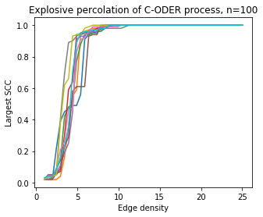
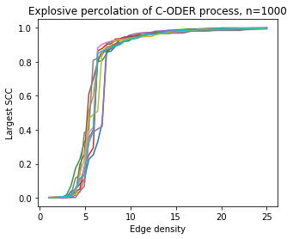
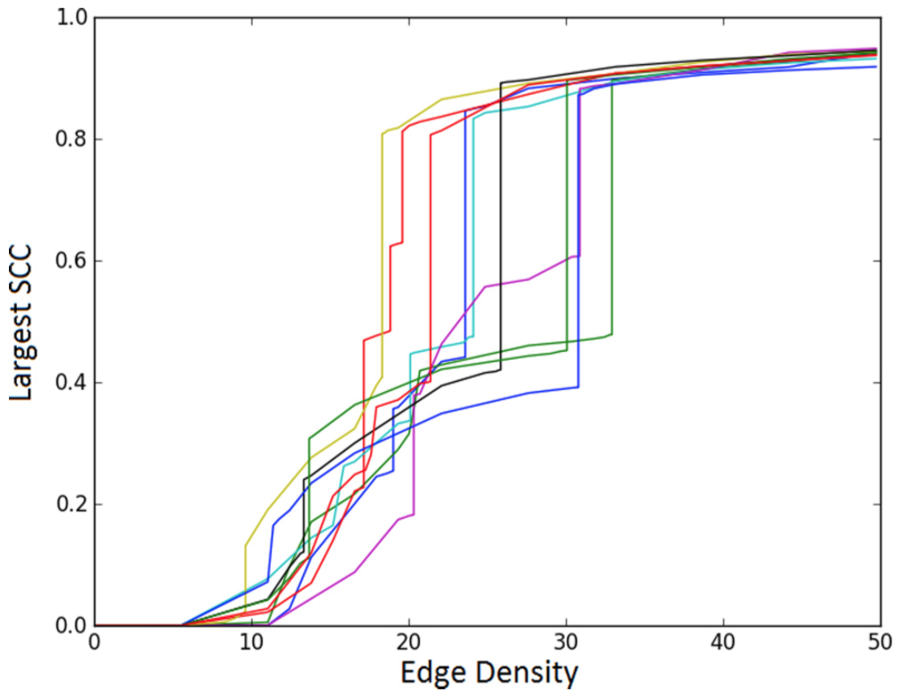
C-ODER: Able to replicate large SCC jumps observed in paper (w/caveat)
Percolation
Cluster definitions
Cluster algorithms
Critical exponents
Target results
My results
Simulation notes: 10 replicates were run for each system size; built graph with 50 edge density points between 1 and 25

Slide 12
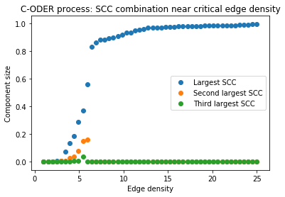
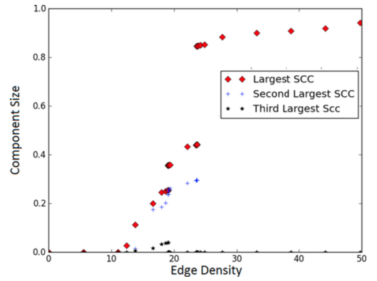
Why might this be?: Able to replicate “jump” mechanism– SCC combination near δ_{c}
Percolation
Cluster definitions
Cluster algorithms
Critical exponents
My results
Target results
Range of δ_{c} seen in simulation
Simulation notes: 1 replicate shown for system size of n=1E2

Slide 13
Why might this be?: Edge density is not a great proxy for percolation occupancy p
Percolation
Cluster definitions
Cluster algorithms
Critical exponents
This paper frames edge density as an analog for the probability of a site being occupied
As we’ve seen in class, there’s some p_{c} at which the probability of there being a percolating cluster jumps– p_{c} does not vary with system size
The better analogous property would actually be the percentage of the system an average node is connected to
.... Unfortunately, that doesn’t actually work, as shown on the next slide
Notes:
It’s not that this paper is incorrect– it’s just perhaps misguided in its framing of the issue

Slide 14
A node’s fractional connection to the rest of system isn’t a good proxy, either (boo)
Percolation
Cluster definitions
Cluster algorithms
Critical exponents
Nodes (n)
Largest SCC versus fractional connection
1e2
1 = 1e-2
25 = 2.5e-1
If anyone has other ideas, I will try them!
1e3
1 = 1e-3
25 = 2.5e-2
…
1e6
1 = 1e-6
Fraction of system an average node is connected to
50 = 5e-5
Simulation notes: 10 replicates were run for each system size; built graph with 50 edge density points between 1 and 25

Slide 15
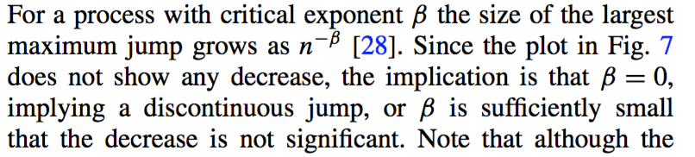

Size invariance: Replicate finding that β is ~zero for the scaling of the largest jump
Percolation
Cluster definitions
Cluster algorithms
Critical exponents
“The only exception seems to be global competition, where we find β indistinguishable from zero and ΔC_{max}/N≅0.5>0 for all N, indicating a strongly discontinuous transition…”
Notes:
Beta as we study it is the scaling for the probability of being in the percolating cluster– which doesn’t really exist here.

Slide 16
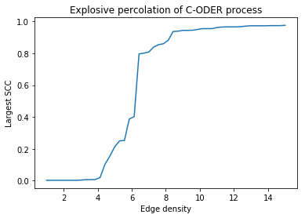
To avoid calculating the SCC after the addition of each edge, use a binary search
Percolation
Cluster definitions
Cluster algorithms
Critical exponents
1
1
2
3
4
4
3
4
2
3
1
2
Graph built through incremental addition of edges
Simulation notes: 1 replicate shown for system size of n=1E2

Slide 17
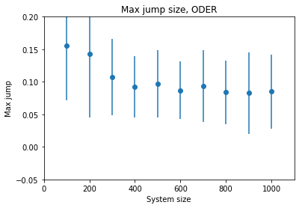
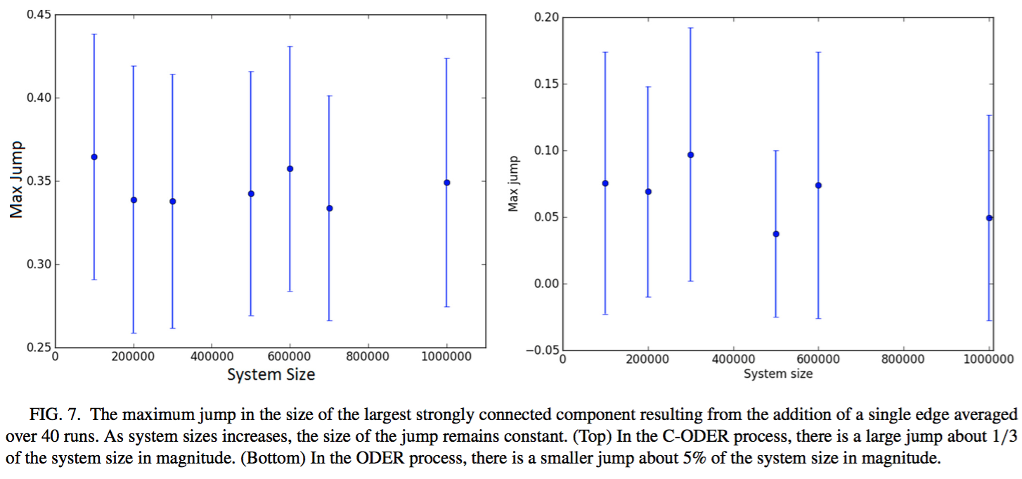
ODER: I can buy that β is “indistinguishable from zero” here
Percolation
Cluster definitions
Cluster algorithms
Critical exponents
My results
Paper’s results
Simulation notes: 40 replicates were run for each system size; system sizes n=1E2-1E3; edge density of 50
Paper simulation notes: 40 replicates were run for each system size; system sizes n=1E5-1E6; edge density not provided

Slide 18
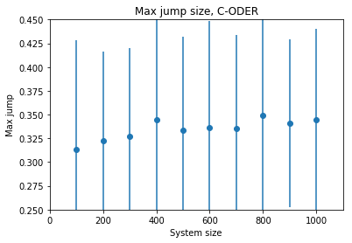
C-ODER: Results consistent with paper
Percolation
Cluster definitions
Cluster algorithms
Critical exponents
My results
Paper’s results
Simulation notes: 40 replicates were run for each system size; system sizes n=1E2-1E3; edge density of 50
Paper simulation notes: 40 replicates were run for each system size; system sizes n=1E5-1E6; edge density not provided

Slide 19
Conclusion: Able to replicate this paper fairly closely and found some holes along the way
Was able to replicate main findings from a paper in a field I knew very little about, and in a reasonable amount of time!
Always interesting to try to replicate papers, and realize what’s missing– key parameters, explicit details of algorithms
Next steps:
Networkx: gold standard for network classification, and has an SCC function; would need to create ODER and C-ODER within the Networkx framework to use, but it’s not a horrible task

Slide 20
Thanks for coming despite the snow!

Slide 21
Methods: Clustering algorithms
Percolation
Cluster definitions
Cluster algorithms
Critical exponents
Hoshen-Kopelman – O(N)
Allocate an array of size N to store the cluster label for each site
Allocate a dictionary to map initially-assigned cluster labels and their actual labels
Loop through all sites “I” in the lattice:
If occupied: get cluster labels from neighboring occupied sites
If only 1 neighbor site is occupied & has cluster label assigned: assign same label to this site
If >1 neighbor site are occupied & all have same label => assign label to this site
If >1 neighbor site are occupied & have diff labels => assign lowest labeled site
For labels not chosen => if chosen label <
If no neighboring cluster labels: assign a new cluster label to this site

